Slide 1
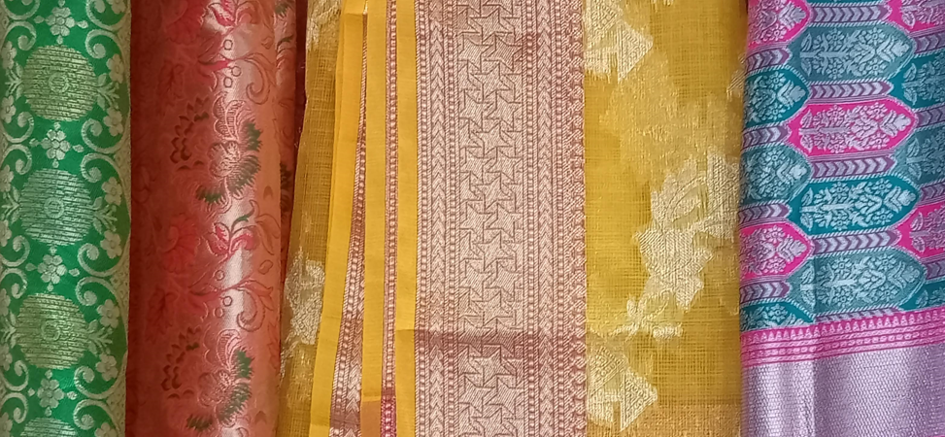
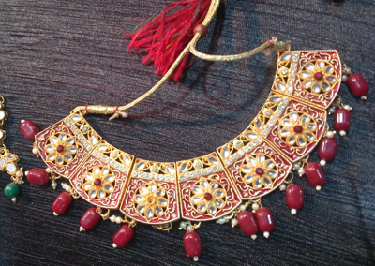
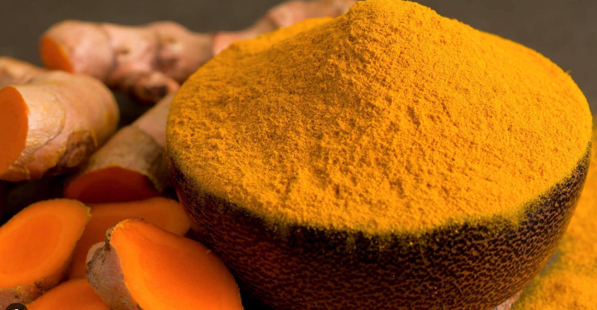
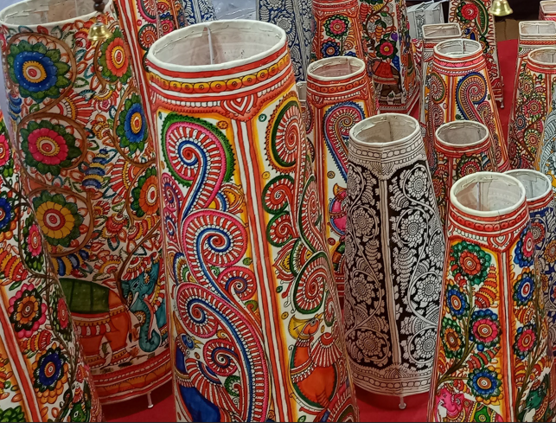
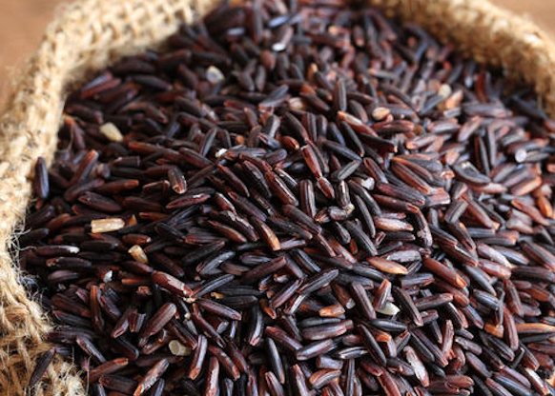
INDIA AGELESS
TEAM NAME : GI VISIONARIES
NSTI: NSTI-BHUBANESWAR
ADIT BATCH : 2022-24

Slide 2



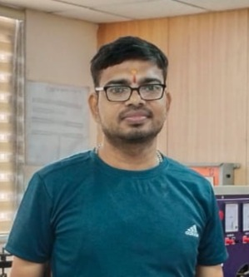
MEET OUR TEAM
SANTOSH KUMAR BARAL
GROUP LEADER
UZMA USMANI
TEAM MEMBER
AVIJIT DUTTA
TEAM MEMBER
SUSHANT SAHOO
TEAM MEMBER

Slide 3
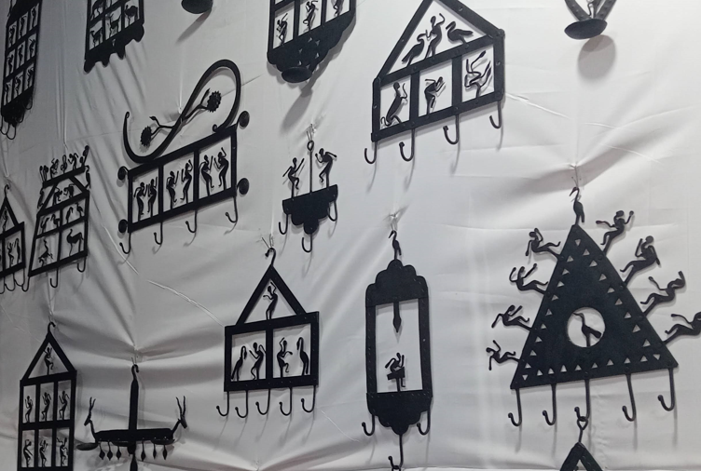
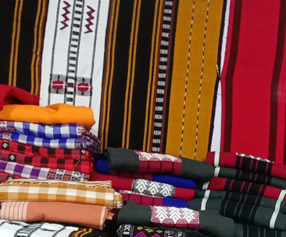
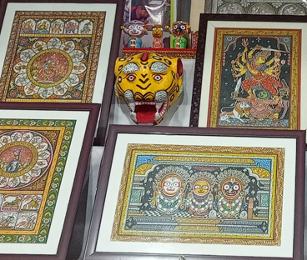
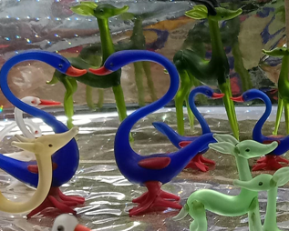
AGENDA
INTRODUCTION
PROBLEM STATEMNT
OBJECTIVE
CASE STUDY
THE END USERS?
OUR SOLUTION AND ITS VALUE PROPOSITION
FEATURES
THE WOW IN OUR SOLUTION
USER INTERACTION MODEL
CONCLUSION

Slide 4

Do you know that some products have a special tag that shows where they come from?

Slide 5
INTRODUCTION- Geographical Indication
It should have a special quality or reputation or other characteristics.
Used to identify goods having special characteristics originating from a definite geographical territory.
It is an indication.
Originates from a definite geographical territory.
The manufactured goods should be produced or processed or prepared in that territory.
Used to identify agricultural, natural or manufactured goods.

Slide 6
INTRODUCTION - Benefits of GIs
It boosts the export.
It promotes economic prosperity of producers of goods produced in a geographical territory.
It confers legal protection.
It prevents unauthorized use of a Registered Geographical Indication by others.

Slide 7


PROBLEM STATEMENT
Lack of awareness about Geographical Indication (GI) tags and their associated products hinders consumers from making informed choices.
Many are unaware of the unique qualities and cultural significance of GI-tagged items.

Slide 8



OBJECTIVE
Develop a comprehensive website focused on educating users about GI tags and the products they represent.
The website will serve as a centralized platform to raise awareness, provide information, and promote the cultural and economic value of GI-tagged products.

Slide 9

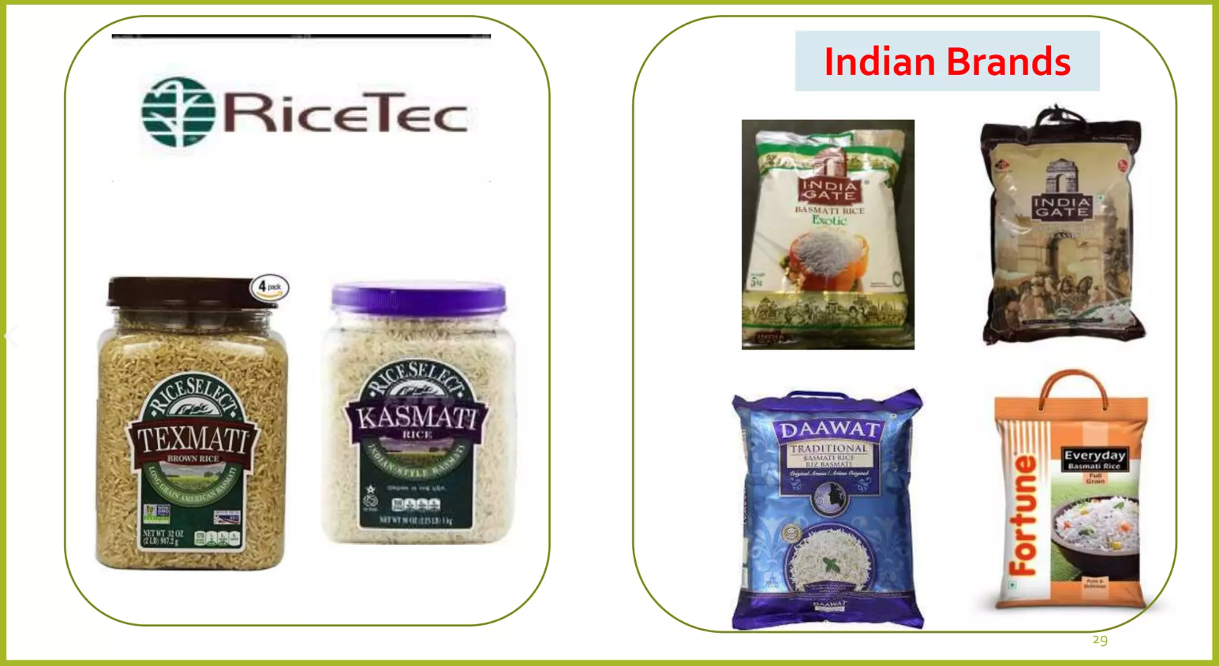
CASE STUDY
In 1997, an American company RiceTec Inc, got patent for BASMATI.
Entered the international market with brands like ‘Kasmati’ and ‘Texmati’.
India objected to it.
“Patenting Basmati in the US is like snatching away our History and culture.”
In 2000,Rice Tec chose to withdraw its claims.

Slide 10

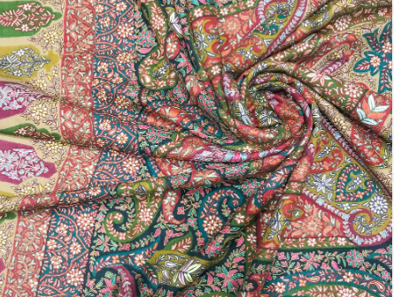
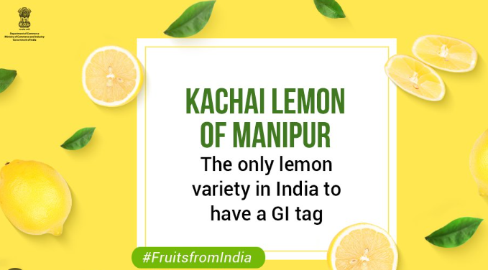
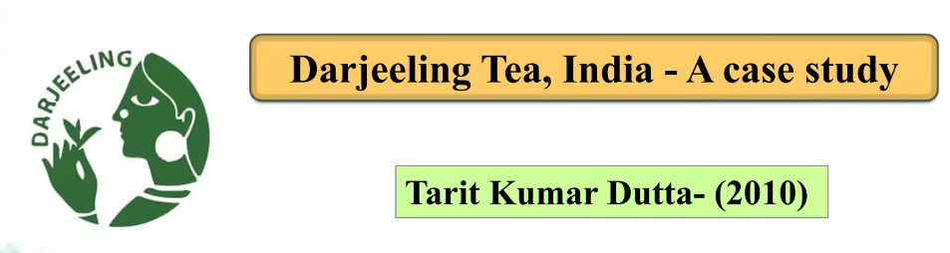
CASE STUDY
Pashmina Shawl
Kasturi Das(2009)
Telangana
Pochampally Ikat

Slide 11

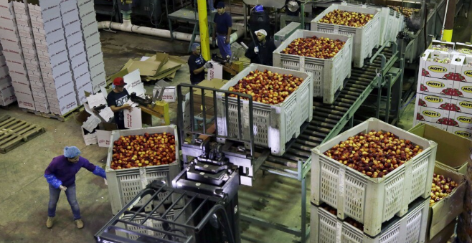

THE END USERS?
Consumers: Seeking information about GI-tagged products.
Producers: Looking to showcase and promote their GI-tagged items.
Researchers: Exploring the cultural and economic impact of GI tags.

Slide 12

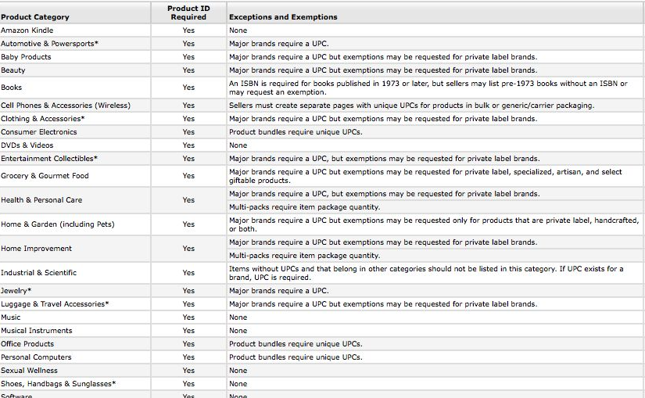
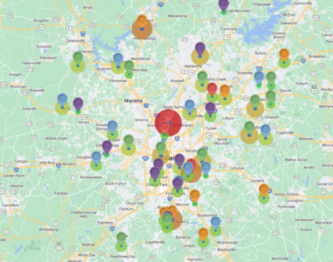
OUR SOLUTION AND ITS VALUE PROPOSITION
Educational Content: Detailed information about GI tags, their importance, and the diverse products associated with them.
Product Listings: A database of GI-tagged items, their origins, and unique features.
Interactive Map: Visual representation of GI-tagged regions, enhancing geographical understanding.

Slide 13



FEATURES
EDUCATIONAL RESOURCES
DEVICE RESPONSIVENESS
MULTILINGUAL SUPPORT
FAQ & RESOURCES
INTERACTIVE TOOLS AND MULTIMEDIA
VIDEOS
QUIZZES
CASE STUDIES

Slide 14
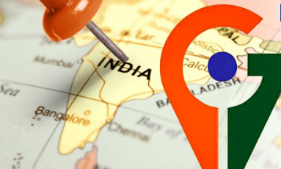


THE WOW IN OUR SOLUTION
Implement a virtual tour feature, allowing users to explore the regions linked to GI tags through immersive multimedia experiences, connecting them directly with the cultural roots of the products.

Slide 15
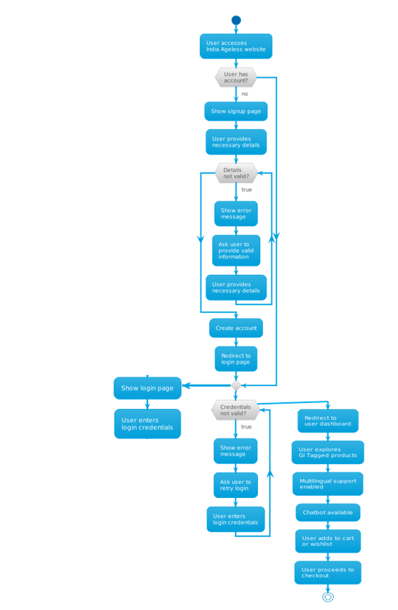
USER INTERACTION MODEL

Slide 16

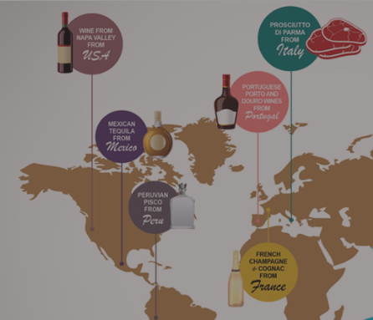

FUTURE ENHANCEMENT
MAKE INTO A ONLINE MARKETPLACE-Embedding traditional brands in a Global space.
INCREASE THE CONTENT TO INTERNATIONAL GI TAGGED PRODUCTS ALSO.
Community Engagement: Forums and discussions to foster a community interested in GI tags

Slide 17

CONCLUSION
This solution not only educates but also fosters a sense of connection between consumers and the diverse cultures behind GI-tagged products, adding significant value to both producers and consumers.

Slide 18


Thanks all for being part of our Vision.

